Slide 1
ORL 5524-Session 5.0
Instrument Design and Validation
Madhabi Chatterji, Ph.D.
Professor of Measurement, Evaluation and Education
Director, Assessment and Evaluation Research Initiative (AERI)
Teachers College, Columbia University

Slide 2
Agenda
  Review Homework—Draft of Validation Plans
Applied examples—lecture-discussion
  Case 1: Measures of Chatterji & Lin (2018)
  Case 2 Pittsburg sleep quality index Beaudreau et al, 2013)
  Case 3 ORL 5524-Student example (HOMPSHA)
  Next Week: Domain specification and item writing/selection- Begins! Readings Chapters 5-6-7, EA

Slide 3
Homework: An Example of a
Validation Plan and Domain Specifications from ORL 5524
What? Construct(s): Specify Domain(s), indicators, and write/select items/tasks
Why? Purpose (Score-based Inferences and Uses):
On Whom? Population and units:

Slide 4
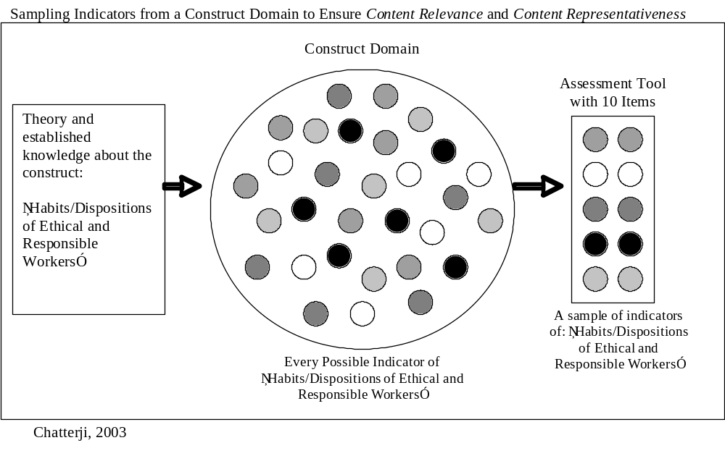

Slide 5
Assessment design specifications for a math test (excerpted from M. Kapur, ORL 5524 student, 2006)
  What? Construct: Higher Order Mathematical Problem Solving Heuristic
  Ability (HOMPSHA, specified as a cognitive construct)
  Purpose:
        Score-based Inferences: To make norm-referenced interpretations from “composite” test scores of higher order mathematical problem-solving heuristics ability
        Uses/Actions: Low stakes. To identify students for an advanced mathematical training program and conduct longitudinal research study of program impact
        Users: Researcher, education leaders and teachers
  Population and units:
    12th Grade students in India performing at the 90th percentile or better in Mathematics
    Units--student-level (inferences would apply to students only)

Slide 6
General Indicator: Given a mathematical sequence, students will be able to identify patterns and use them to solve the problem within 4.5 minutes on average
  1.1 Specific Indicator: Calculate the sum of the terms of the given sequence (Items 1, 2, 5)
  1.1.1 Identify a pattern in the terms of the sequence
  1.1.2 Devise and test a strategy (such as telescoping summations etc.)
  1.1.3 Apply the strategy and calculate the sum of the terms in the given sequence
  Matching Item : The sum of 1/1.2+1/2.3+1/3.4..+1/99.100= ____?
  PARSING INDICATOR STATEMENTS TO WRITE MATCHING ITEM-
  Given a mathematical sequence: CONDITION
  Identify; solve the problem: COGNITIVE PROCESS/BEHAVIOR
  Patterns: CONTENT
  In 4.5 minutes on an average: CRITERION

Slide 7
EXAMPLE: Unified Validation Plan for HOMPSHA (Kapur, 2006)
Validation Question | Rationale | Evidence Sought | Design/Analytic Method
1. Do the problem solving items tap behavior consistent with the theoretical definition of HOMPSHA so as to allow inferences about it? | To ensure content relevance and representativeness of items | Content-based validity | Objective content reviews of the problem solving tasks by math experts and comparison of items with other math achievement tests
2. Are there four latent factors, consistent with the theoretical domain structure? Doe the factors inter-correlate as expected? | To check and ensure internal structure | Internal structure validity | Empirical correlations of sub-test scores with each other, and and/or factor analysis of items
3. Does student performance, as evidenced by the “composite” scores, predict future performance in the advanced mathematical training program? | To justify placement in the program based on performance on this tool | Predictive validity | Empirical correlations with performance scores gathered at the end of the advanced training program
4. Does the “composite” (sum of all subtest scores) test score show internal consistency reliability? | To check for homogeneity of item responses with adjusted total scores | Internal consistency reliability | Calculate (1) Cronbach’s alpha, (2) Split-half reliability of total scores Check sub-domain score reliabilities
5. Would the scores/ results remain the same if two different but equivalent (or parallel) forms were administered? | To check for item sampling error due to alternate parallel forms | Parallel-forms reliability or split-half reliability coefficient | Split-half reliability Divided test into “half” test forms and calculate reliability coefficient

Slide 8
Homework for the next class: Your validation plan
Validation Question | Rationale | Evidence Sought | Design/Analytic Method

